Slide 1

Project Skyline
Building an open-source, consumer-facing, user interface for Triton DataCenter
Notes:
Hello. We are Project Skyline, and we are building an open-source, consumer-facing, user interface for the Triton DataCenter cloud management platform. (~10 seconds)

Slide 2
Group members and project advisor
Group Members:
Matt Osbourne - osbourma@mail.uc.edu
Spencer Dangel - dangelsc@mail.uc.edu
Alec Reser - reserad@mail.uc.edu
Project Advisor:
Patrick Olekas - olekaspt@mail.uc.edu
Notes:
My name is Matt Osbourne, and on this project I am joined by Spencer Dangel and Alec Reser. Our project advisor is Patrick Olekas. (~10 seconds)

Slide 3
Project Abstract
The purpose of this project is to create an open source, consumer-facing, user interface for the Triton DataCenter cloud management platform. The finished product of this project will be a fully functioning user interface that allows users to log in, manage their account, and to create, update, and maintain their own virtual machines, virtual machine images, and virtual networks that are hosted on a Triton DataCenter instance using this user interface. This is beneficial because it is a simplified and streamlined process that will allow a user with little technical knowledge to interact with virtual systems hosted by the Triton DataCenter cloud management platform.
Notes:
[ Just read the abstract ] (~30 seconds)

Slide 4
User stories
As a user, I want to be able to edit my account details so I can keep my contact information up to date.
As a user, I want to be able to create virtual machine instances so I can use them for projects.
As a user, I want to be able to delete virtual machine instances so they are no longer taking up space when I don't need them.
As a user, I want to be able to create virtual networks so I can control how my virtual machine instances communicate with each other.
As a user, I want to be able to create virtual machine images so I can use them to quickly deploy virtual machine instances.
Notes:
Our project user stories are as follows: [ Just read the user stories ] (~40 seconds)

Slide 5
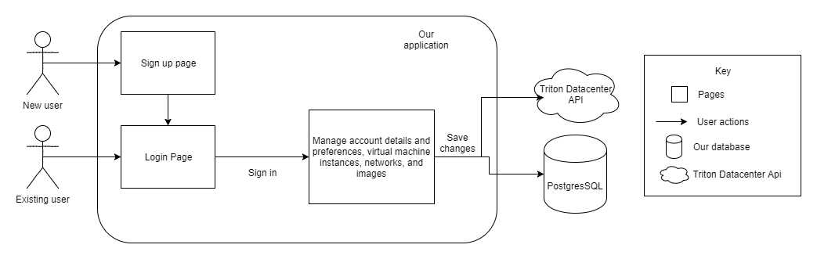
Design Diagram 1
Notes:
The image shown here is that of our first design diagram, with little detail and abstraction. As you can see, a new user can access the application and will be directed to our account creation/signup page. When they have created an account, they then follow the same path as an existing user, and they will log in. When a user has logged in, they will be redirected to a page where they are able to manage their account details, as well as their virtual machine images, virtual networks, and running virtual machines. Changes made on the account management page will be saved in either a PostgreSQL database, or through the Triton DataCenter API. (~35 seconds)

Slide 6
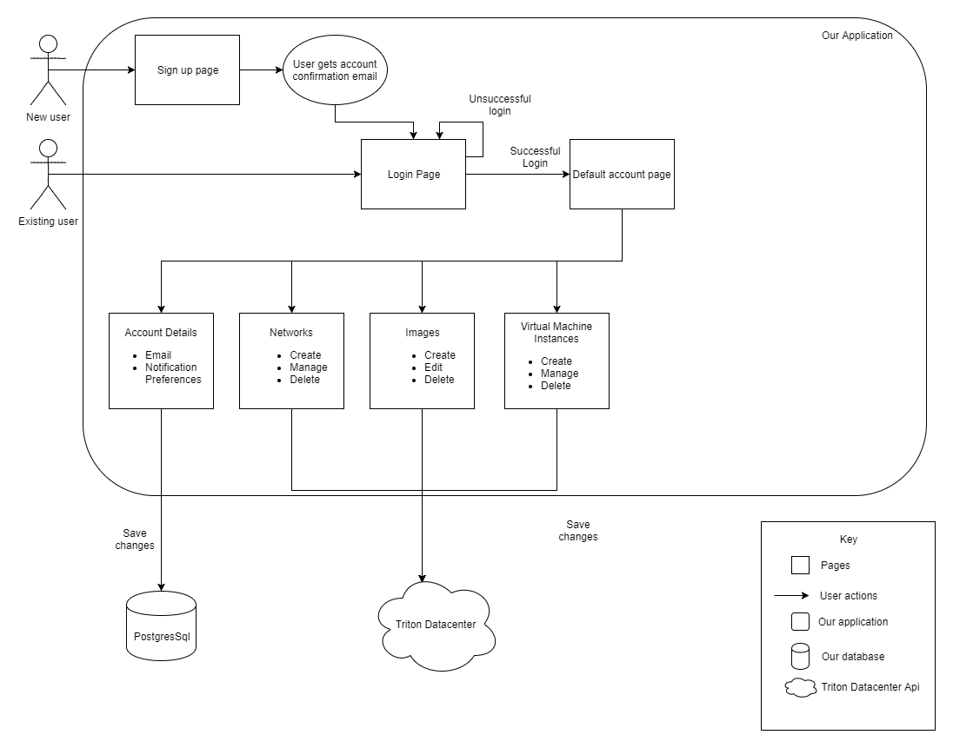
Design Diagram 2
Notes:
The image shown here is that of our second design diagram, with more detail than the first. A new user will start by reaching the signup page, and when they have entered the required information, they will be sent an account creation confirmation email and will be directed to the login page. From there, an existing user will enter their login details, if their information is incorrect, they will stay on the login page, and if it is correct they will be redirected to the default account page. On the default account page, a user will have the ability to edit their email and notification preferences, as well as create, manage, and delete settings on their virtual machines, virtual machine instances, and virtual networks. The changes made on this page that relate to the account details will save to a PostgreSQL database, and the changes made that relate to virtual machines and virtual networks will be sent to the Triton DataCenter API.

Slide 7
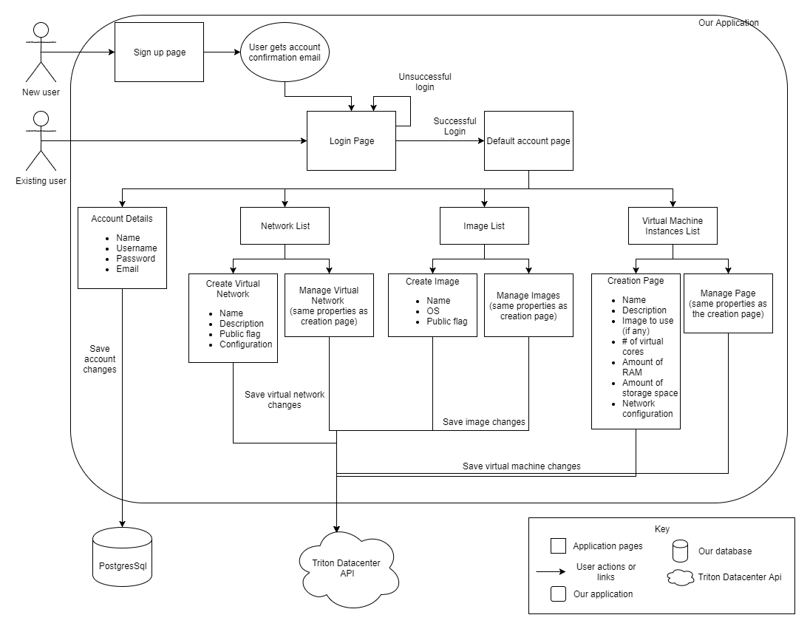
Design Diagram 3
Notes:
The image shown here is that of our third design diagram, with the most detail. As you may notice, the signup and login pages are unchanged. The additional detail that we provide is in the default account page. In the account details section, in addition to changing a user’s email preferences, a user can also change their name, username, password, and contact email address. In the network list section, a user will be able to create or edit the name, description, public flag, and configuration of their virtual networks. In the virtual machine image section, a user will be able to create or edit the name, operating system, and public flag of their virtual machine images. In the virtual machine instances list section, a user will be able to create or edit the name, description, image (if they have any preconfigured in the virtual machine images section), number of virtual cores, amount of RAM, amount of storage space, and the network configuration of a virtual machine instance. The changes are then saved in the same way as we described on the previous design diagram.

Slide 8
Technology Stack
Aurelia + Typescript client application
NodeJS + Hapi server
PostgreSQL database
Notes:
We have decided that our technology stack for implementing these features will utilize a split client and server applications, allowing us to host the client and server instances on separate servers. For the client application, we will be using the Aurelia javascript framework and add types to the language using Typescript. The server will be built with NodeJS and utilize the Hapi plugin for creating a REST api. All of our data will be stored in a PostgeSQL database.

Slide 9
Task list & division of work
Research Trition DataCenter API endpoints (Spencer) Decide on frontend/backend/database frameworks for use (Alec) Create unit test file and add basic unit tests (Matt) Create basic design template for whole application (Spencer) Create signup page and controller (Alec) Create login page and controller (Matt) Create default account management page - Account details and edit section (Spencer) Create network list management section on account management page (Alec) Create image list management section on account management page (Matt) Create virtual machine instances list section on account management page (Spencer) Create service to connect changes on frontend to the Triton DataCenter API(Alec) Create service to connect account detail changes to PostgreSQL database (Matt)
Notes:
[ Read the user stories ]
As you can see, our division of work was to just order our tasks and then assign each task to a person in order and repeat until we were done, and we feel that this is an appropriate distribution of work for our project.

Slide 10
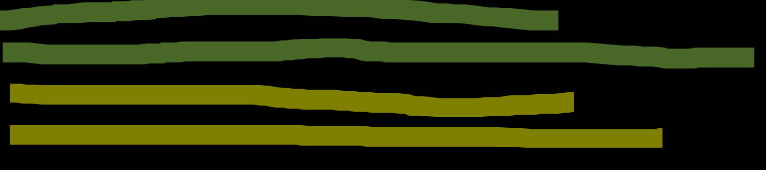
Where are we now?
Research Trition DataCenter API endpoints (Spencer) Decide on frontend/backend/database frameworks for use (Alec) Create unit test file and add basic unit tests (Matt) Create basic design template for whole application (Spencer) Create signup page and controller (Alec) Create login page and controller (Matt) Create default account management page - Account details and edit section (Spencer) Create network list management section on account management page (Alec) Create image list management section on account management page (Matt) Create virtual machine instances list section on account management page (Spencer) Create service to connect changes on frontend to the Triton DataCenter API(Alec) Create service to connect account detail changes to PostgreSQL database (Matt)
Notes:
So far, we have completed our research on the Triton DataCenter API endpoints, and we have decided the frameworks we are going to use for this project. We are currently working on creating our basic unit test file and making our basic design template for the whole application. We are basically at a point now where we are ready to begin the actual development work for our project.

Slide 11
Accomplishments this semester?
We discovered a problem that could be solved throughout the process of senior design
We planned out and designed a software solution to this problem
We’ve started to build our proposed software solution
Notes:
This semester, we have accomplished a few things shown here. For starters, we discovered that there isn’t a consumer-facing user interface for Triton DataCenter, that allows users with little technological knowledge to spin up and manage virtual machines and virtual networks. Next, we completed the weekly tasks for this class, planning out our application and creating the roadmap that we will use to bring this application to life. Finally, we are now at a point where we are ready to get into the thick of this project and begin the actual development work.

